Slide 1

Challenge: Analysing Historical IPL data and provide insights on IPL 2024 for a sports magazine
Problem Statement
"Sports Basics" is a sports blog company that entered space recently. They wanted to get more traffic to their website by
releasing a special edition magazine on IPL 2024. This magazine aims to provide interesting insights and facts for fans,
analysts and teams based on the last 3 years' data.

Slide 2
DATASETS AVAILABLE
This document contains all the meta information regarding the columns described in the CSV files for a comprehensive analysis of IPL matches over the past three years (2021, 2022, 2023). We have provided 4 CSV files:
1. dim_match_summary
2. fact_batting_summary
3. fact_bowling_summary
4. dim_players
TOOLS USED BY ME :
EXCEL
POWERBI

Slide 3
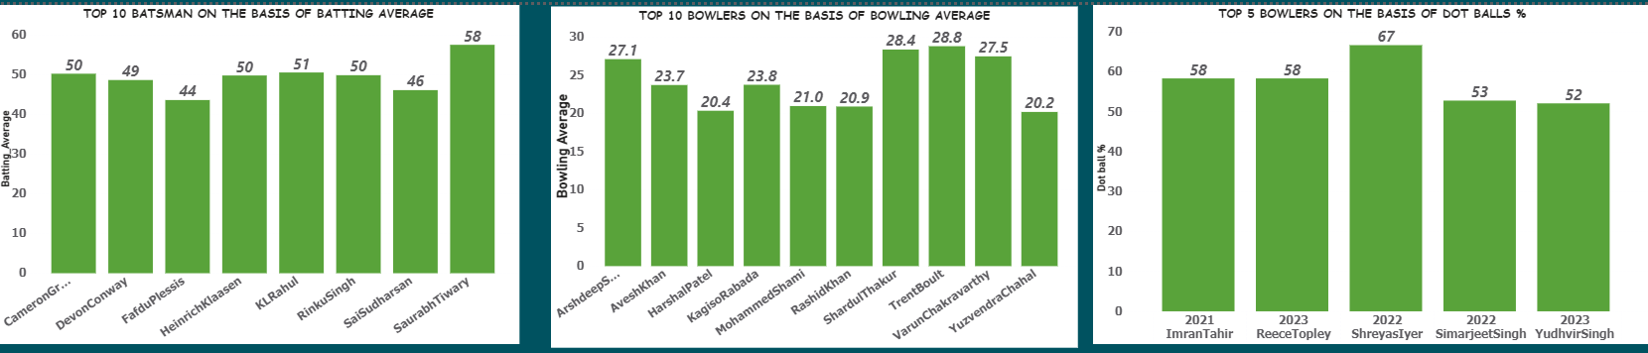
PRIMARY INSIGHTS
8

Slide 4
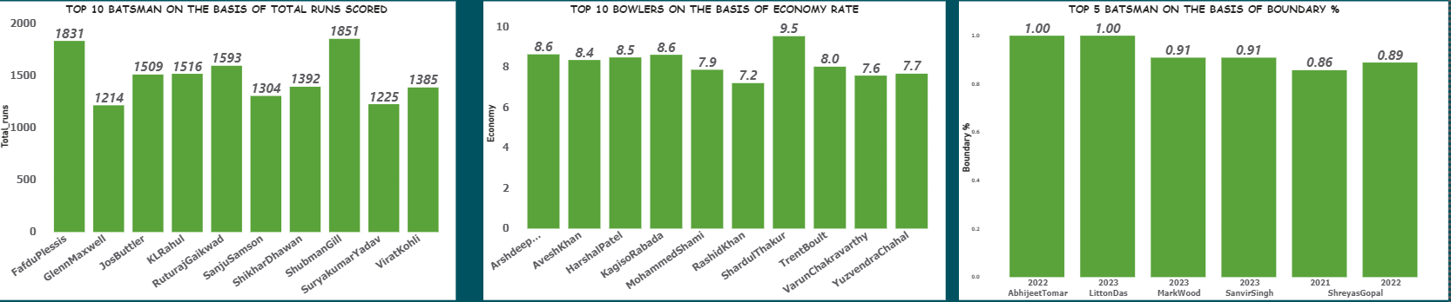
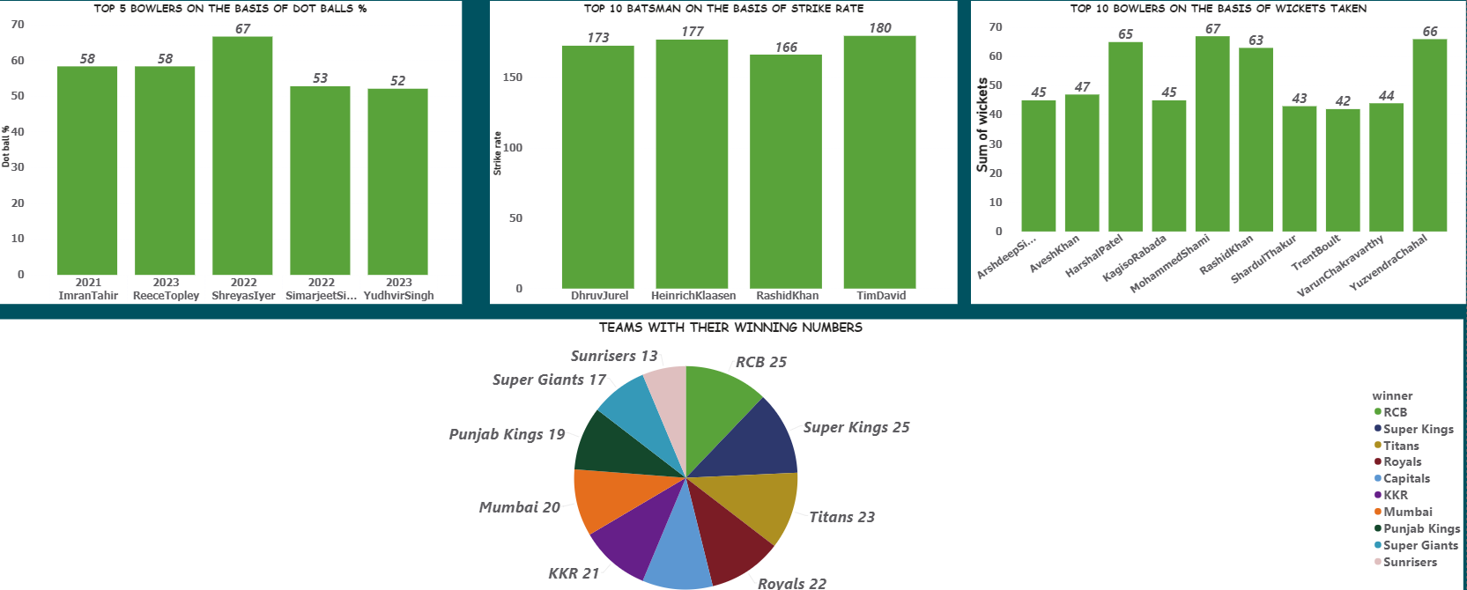

Slide 5
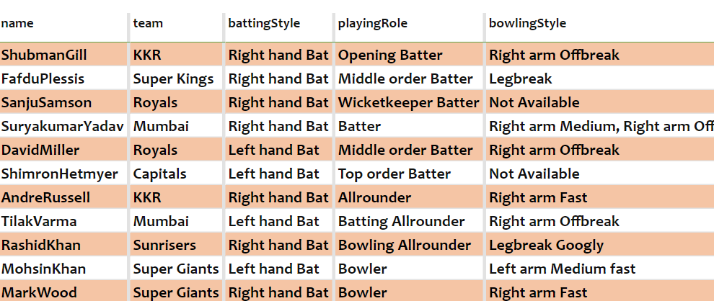
SUPER 11

Slide 6
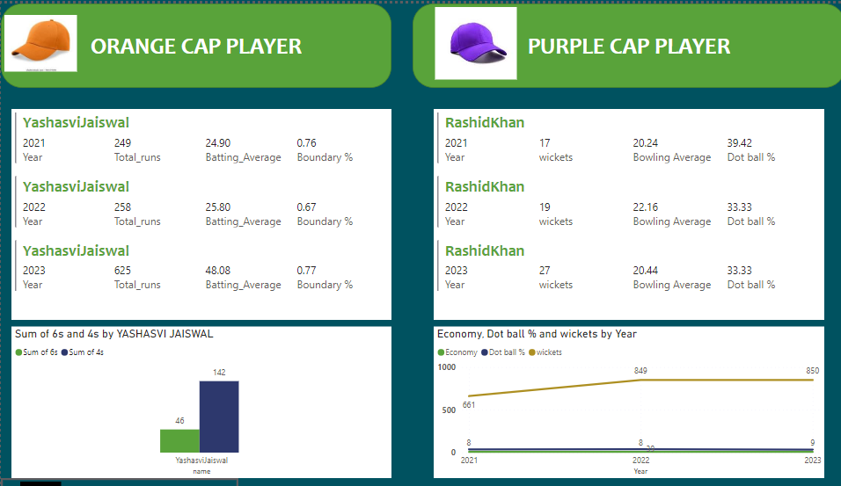
ORANGE CAP/PURPLE CAP PLAYER

Slide 7
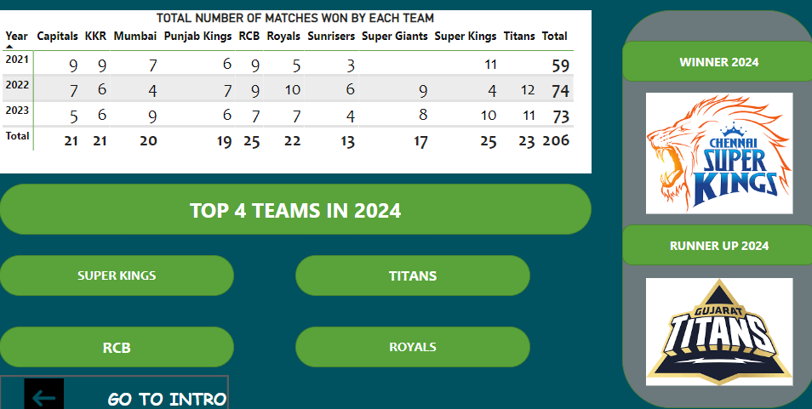
PREDICTIVE ANALYSIS

Slide 8
THANK YOU!!
I WOULD LIKE TO EXPRESS MY GRATITUDE TO THE CODEBASICS TEAM FOR PROVIDING THIS RESUME CHALLENGE.

